Slide 1
HASHING

Slide 2
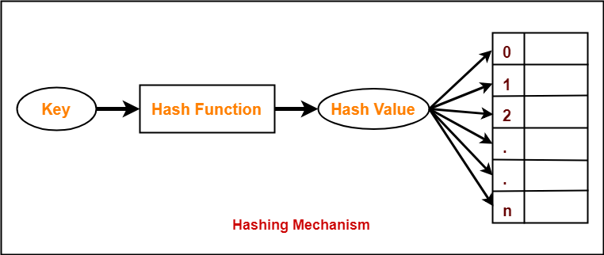
HASHING: O(1) -A technique for storing data. -It performs insertions,deletions and search operation in constant average time. -Hashing technique converts a range of key values into a range of indexes of an array. -Hashing is used to implement hash tables. -Hash function is used to map a given value with a particular key for faster access of elements.

Slide 3
TYPES OF HASHING: STATIC HASHING: -Hash Function maps search key values to a fixed set of locations. DYNAMIC OR EXTENSIBLE HASHING: - Data buckets are added and removed dynamically and on demand. The associated hash function must change as the table grows.

Slide 4
HASH TABLE: -A hash table is a data structure that is used to store keys/value pairs. -Insertion of data in a table is based on a key value. -A key is a value associated with each record. -Data is stored in an array format, where each data value has its own unique index value. -An array of ‘m’ locations called buckets. -Data buckets are memory locations where the records are stored. - It uses a hash function to compute an index into an array in which an element will be inserted or searched.

Slide 5
APPLICATIONS OF HASH TABLE: -Hashing is used in data encryption. Passwords can be stored in the form of their hashes so that even if a database is breached, plaintext passwords are not accessible. MD5, SHA-1 and SHA-2 are popular cryptographic hashes. -Associative arrays -Database indexing -Browser Caches -Sets -Object representation -Network processing algorithms -Data dictionaries -Symbol tables

Slide 6
HASH FUNCTION: -Maps an element’s key into a valid hash table index. -A key can be a number,a string,a record..etc. -Hash function is applied on a key by which it produces an integer, which can be used as an address of hash table. -The same hash function can be used for accessing the data from the hash table. -The integer value returned by the hash function is called hash key or hash value or hash codes or hash sums or simply hashes. EXAMPLE: HASH VALUE(index) = KEY VALUE % array_size

Slide 7
Basic requirements of good hash function : -Easy to compute -Uniform distribution -Less collisions -Use all information provided in key COLLISION: -A hash function can result in M-1 mapping. -It maps two or more keys to same array index; which results in collision.

Slide 8
TYPES OF HASH FUNCTIONS: 1.Division method 2.Mid square method 3.Folding method 4.Pseudo Random Number Generator method 5.Digit or Character extraction or Truncation 6. Radix Conversion

Slide 9
1.Division Method: In this, the hash function is dependent upon the remainder of a division. Hash Function : h(key)=keyvalue%table size Ex: table size =50 reg no=101,102… h(k)=101%50=2 so in array index 2 ;101 is stored

Slide 10
2.Mid square method: In this method firstly key is squared and then mid part of the result is taken as the index. Example: consider that if we want to place a record of 3101 and the size of the table is 1000. So 3101*3101=9616201 h (3101) = 162 (middle 3 digit)

Slide 11
3.Digit folding method: In this method, the key is divided into separate parts and by using some simple operations these parts are combined to produce a hash key. -Shifting folding -Folding at the boundaries

Slide 12
Shifting Folding: -Key is broken into several parts of same length of the required address & then added to get the hash value. -Final carry is ignored. example: Table size:1000 consider a record of 12465512 then it will be divided into parts i.e. 124, 655, 12. After dividing the parts combine these parts by adding it. h(key)=124+655+12

Slide 13
Folding at the boundaries: -This method splits the given key value into n number of parts of same length and reverses the partitions at the boundary. -The reversed partitions are added with the rest of the non boundary parts to give the hash value. Ex: key 123203241 Table size:1000 split 123,203,241 Reverse :321,203,142 Add the partitions:321+203+142=666

Slide 14
4.Pseudo Random Number Generator method -Random number generated is transformed to produce a valid hash value using modulo division. -Generates same random value for a given key. Hashvalue=constant*(key%tablesize)

Slide 15
5.Digit or Character extraction or Truncation -Based on distribution of digits or characters in the key. -Extracts the selected digits from the key and uses it as the address or it can be reversed to give the hash value. Example:key:123203241 table size:1000 Select digits from positions 2,4,5 & 8. 2204 or 4022 is hash value.

Slide 16
6. Radix Conversion Transforms key value into a value of a different system to obtain the hash value. Example: (8465)base10 to (2795)base15 hash table address 2795

Slide 17
COLLISION: -When two or more keys result in the same hash value. -Collision resolution strategies are used to fid another position for the collided record. -Collision resolution techniques: --Open hashing --Closed hashing

Slide 18
Open Hashing: -Each bucket in hash table is the head of a linked list. -All the elements that hash to a particular bucket are placed on that bucket’s linked list. -Collided elements are sorted outside the table.

Slide 19
Closed Hashing: -Collided elements are stored at another slot in the table. -Ensures that all elements are stored directly into the hash table.

Slide 20
Open Hashing :Separate chaining Closed Hashing :Open Addressing, Rehashing, Extendible Hashing

Slide 21
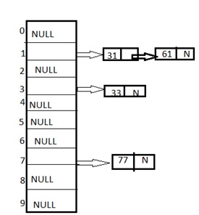
Separate chaining -Maintains a linked list at every hash index for collided elements. -Uses an array of linked lists as hash table. -Each element is inserted into the hash table by creating a new node in the linked list. -When collision occurs between two keys, the linked list is extended by creating a new node & attaching it to the previous node. EXAMPLE: Let us consider a hash table of size 10 and we apply a hash function of H(key)=key % size of table. Let us take the keys to be inserted are 31,33,77,61. In bucket 1 there are two records which are maintained by linked list or we can say by chaining method.

Slide 22
Open Addressing: -If a collision occurs, alternate cells are tried until an empty cell is found. -All the data elements are stored inside the table,a larger memory space is needed. -3 commonly used open addressing collision resolution strategy are: 1.Linear Probing 2.Quadratic Probing 3.Double hashing

Slide 23
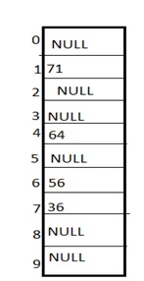
Linear probing -Collision can be solved by placing the second record linearly down, whenever the empty place is found. -In this method there is a problem of clustering which means at some place block of a data is formed in a hash table. Example: hash table of size 10 and hash function is defined as H(key)=key % table size. Consider that following keys are to be inserted that are 56,64,36,71. 56 and 36 need to be placed at same bucket but by linear probing technique the records linearly placed downward if place is empty H(key)=(key+1) % table size; H(key)=(key+2) % table size i.e. it can be seen 36 is placed at index 7.

Slide 24

Quadratic probing -This is a method in which solving of clustering problem is done. -In this method the hash function is defined by the H(key)=(H(key)+x*x)%table size. EXAMPLE -Let us consider we have to insert following elements that are:-67, 90,55,17,49. 67, 90, and 55 can be inserted easily but at case of 17 hash function is used in such a manner that :-(17+0*0)%10=7 (when x=0 it provide the index value 7 only) by making the increment in value of x. let x =1 so (17+1*1)%10=8. in this case bucket 8 is empty hence we will place 17 at index 8.

Slide 25
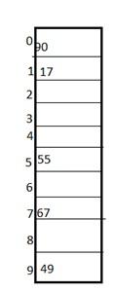
Double hashing: -It is a technique in which two hash function are used when there is an occurrence of collision. -In this method 1 hash function is simple as same as division method. -But for the second hash function there are two important rules which are --It must never evaluate to zero. --Must be sure about the buckets, that they are probed. The hash functions for this technique are: H1(key)=key % table size H2(key)=P-(key mod P) Where, P is a prime number which should be taken smaller than the size of a hash table. Example: Let us consider we have to insert 67, 90,55,17,49. In this we can see 67, 90 and 55 can be inserted in a hash table by using first hash function but in case of 17 again the bucket is full and in this case we have to use the second hash function which is H2(key)=P-(key % P) here P is a prime number which should be taken smaller than the hash table so value of P will be the 7. i.e. H2(17)=7-(17%7)=7-3=4 that means we have to take 4 jumps for placing the 17. Therefore 17 will be placed at index 1.

Slide 26
REHASHING: -Rehashing is the process of re-calculating the hashcode of already stored entries (Key-Value pairs), to move them to another bigger size hashmap when the threshold is reached/crossed. -Rehashing is done because whenever a new key value pair is inserted into map, the load factor increases and due to which complexity also increases. -Load factor in HashMap is basically a measure that decides when exactly to increase the size of the HashMap to maintain the same time complexity of O(1). -Load factor is defined as (m/n) where n is the total size of the hash table and m is the preferred number of entries which can be inserted before an increment in the size of the underlying data structure is required.

Slide 27
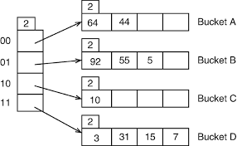
EXTENDIBLE HASHING: -Dynamic hashing technique. -Allows more insertions to be done in a hash table without performance degradation. -Two parts of extendible hashing: --hashing --tries -Keys are put in separate memory space called buckets. -Buckets are independent parts in a disk. -Buckets are linked with a directory. -Directory will act as a reference for accessing any buckets. -Keys with hashing address with same prefix are stored in same bucket. -Tries are used for accessing the keys in the buckets. -The prefix of the hash value is used to locate the right bucket in which the key is located. -If bucket overflow occurs ,bucket is split into two.

Slide 28
-The directory may or may not double ,depending on whether the local depth of the over flown bucket was equal to the global depth before split. -Global depth(g):No of bits used by the hash function to categorize the keys. NO OF DIRECTORIES=2^g -Local depth(l):Associated with buckets. Local depth along with global depth is used to decide the action to be performed in case of bucket overflow. Always l<=g -An overflow of a bucket occurs when the values does not have room to be stored in one particular bucket.

Slide 29
INSERTION: 1.Calculate the hash function for the key and key address in the directory. 2.Follow directory address to find the right bucket for the key. 3.Insert into bucket. Split the bucket if overflow occurs.

Slide 30
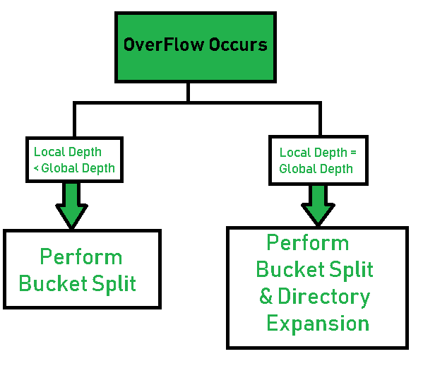

Slide 31
Problem: g=2 bucket size=4 hash function h(k)=key mod 64.Hash the values using extendible hashing.288,8,1064,120,148,204,641,700,258,1586,44,68
key | h(k)=key mod 64 | Bit pattern
288 | 32 | 100000
8 | 8 | 001000
1064 | 40 | 101000
120 | 56 | 111000
148 | 20 | 010100
204 | 12 | 001100
641 | 1 | 000001
700 | 60 | 111100
258 | 2 | 000010
1586 | 20 | 110010
44 | 44 | 101010
68 | 4 | 000010
g=2
00 | 01 | 10 | 11
8
204
641
258
148
288
1064
44
120
700
1586

